Slide 1


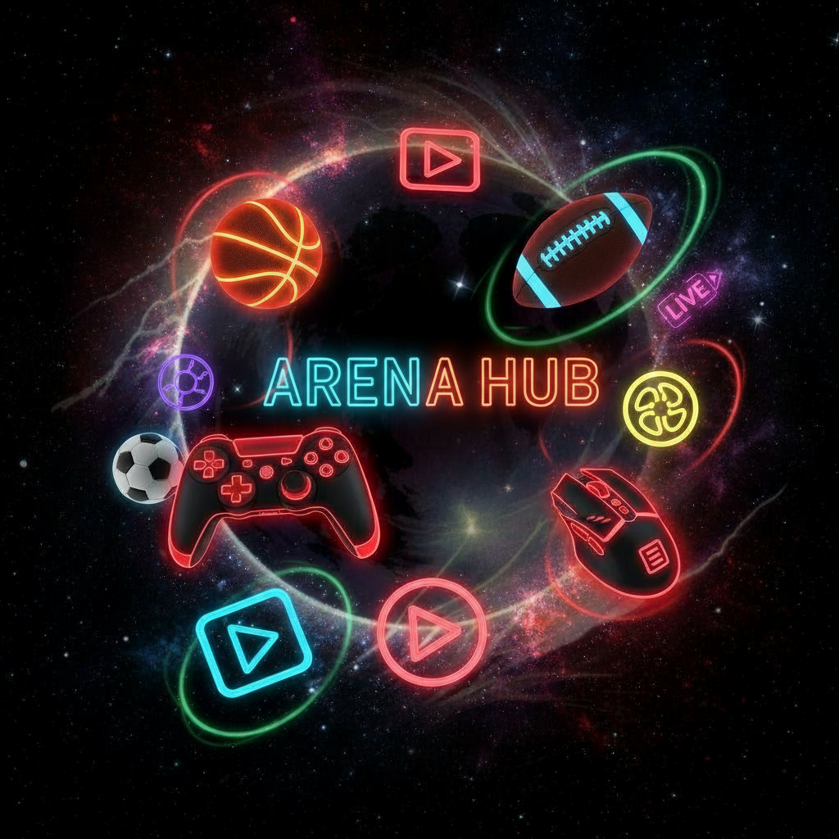
ARENA HUB
Presented By:
Akash G
Manoj Kumar G
Mahendiran R
Deepak E
Narendhar K

Slide 2


CONTENTS
About The project
Problem statements with solutions
Target Audience
Design Process
EMPATHIZE
User Research
User Persona
Empathy Mapping
Information Architecture
User Flow

Slide 3
ABOUT THE PROJECT
Arena Hub is a mobile app that provides a one-stop platform for buying and managing sports and gaming items. Users can browse products, compare prices, and track orders using QR codes. Admins can add products, manage users, and monitor sales. The project aims to simplify sports equipment access and promote digital sports shopping through a smart and user-friendly system.

Slide 4
Real Time Problems and their solutions
PROBLEMS
SOLUTIONS
People struggle to find quality sports equipment and gaming accessories easily.
Local availability and brand comparisons are limited.
Gamers and athletes need a single trusted platform.
One-stop app for sports & gaming gears.
Buy or rent sports equipment.
Compare products and check nearby stores.
Real-time availability and delivery tracking.

Slide 5
TARGET AUDIUNCE
USER GROUP | AGE | LOCATION
Sports Players & Athletes | 15-40 Years | All over India
Gamers And Streamers
Schools And College Students
Shop Owners And Venders
10-50 Years
ALL OVER INDIA

Slide 6
DESIGN PROCESS
1st Week – EMPATHIZE
Competitor Analysis, SWOT Analysis, Research Interview
2nd Week – Define
Persona Creation, Empathy Map, User Map
3rd Week – Ideate
Information Architecture (IA) , User Flow

Slide 7
EMPATHIZE
In my user research, I conducted interviews with 10 individuals, including Sports enthusiast , Athletes and Gamers/Streamers.
Can you describe a recent moment when you felt truly motivated or discouraged during training or competition
What is the biggest challenge you face in accessing sports facilities or equipment?
How do you feel when you miss out on playing because of scheduling or availability issues?
What do you wish your sports environment or community understood about your needs as an amateur athlete?
How do you handle setbacks, like injuries or losses, and what emotional support do you find most helpful?
Can you share a story where a teammate or coach showed empathy or understanding that made a difference?
What would make you feel more included or supported as an amateur in your sport?

Slide 8
USER RESEARCH
Online Survey: Gathered responses from 50+ students, gamers, and athletes.
User Interviews: Conducted short interviews with 10 users from colleges and local sports clubs.
Observation & Competitor Study: Analyzed sports apps like Decathlon, Flipkart Sports, and Sports365.
80% of users prefer online shopping for convenience.
65% reported difficulty finding local brands or stock availability.
Users want trusted seller verification and secure payment options. Students and gamers look for budget-friendly gear and fast delivery.
Store owners need a simple interface to list and track products.

Slide 9

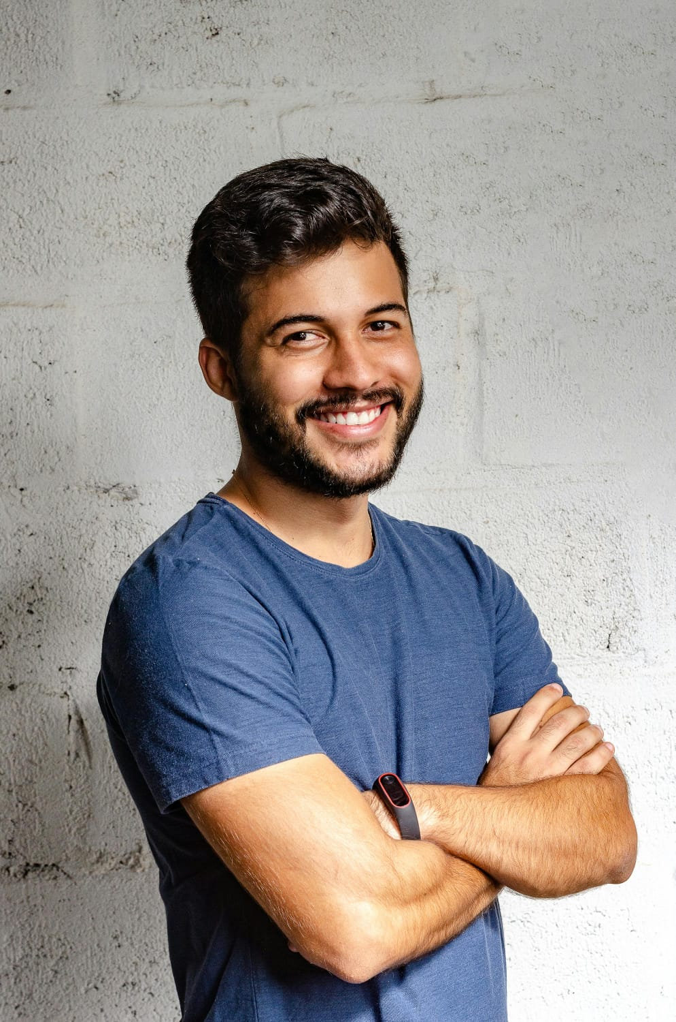
USER PERSONA
User Persona 1 - Sports Player
Name: Rahul Kumar
Age: 21
Occupation: College Student & Football Player
Location: Chennai, India
About: Rahul is a college athlete who regularly participates in football tournaments. He often struggles to find quality sports gear nearby and wants an easy online platform to buy trusted products.
Goals: Buy affordable, branded sports items online.
Track product delivery with QR codes.
Compare prices and reviews easily.
Access sports gear anytime, anywhere.
Frustrations: Poor product availability in local stores.
No proper comparison between brands. Delayed or unreliable deliveries.

Slide 10
EMPATHY MAPPING
USER 2 : Rahul Kumar (Vendor)
SAYS:
"I want to expand my sports shop online.“
"It's hard to manage orders manually.“
THINKS:
"Online presence will increase my customer base.“
"A simple dashboard would make my work easier.“
DOES:
Manages orders using notebooks and phone calls.
Promotes her shop through local ads.
FEELS:
Overwhelmed with offline tasks.
Hopeful about going digital with Arena Hub.

Slide 11
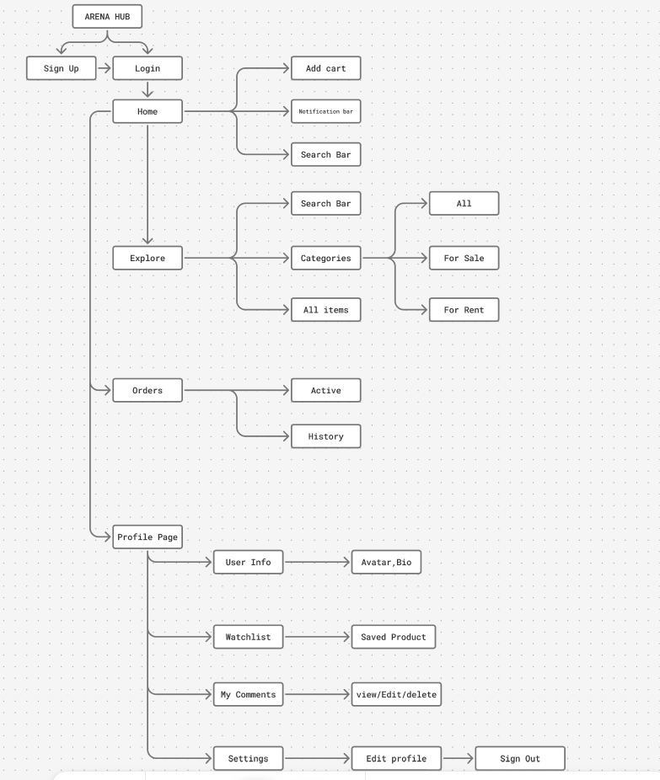
INFORMATION ARCHITECTURE

Slide 12
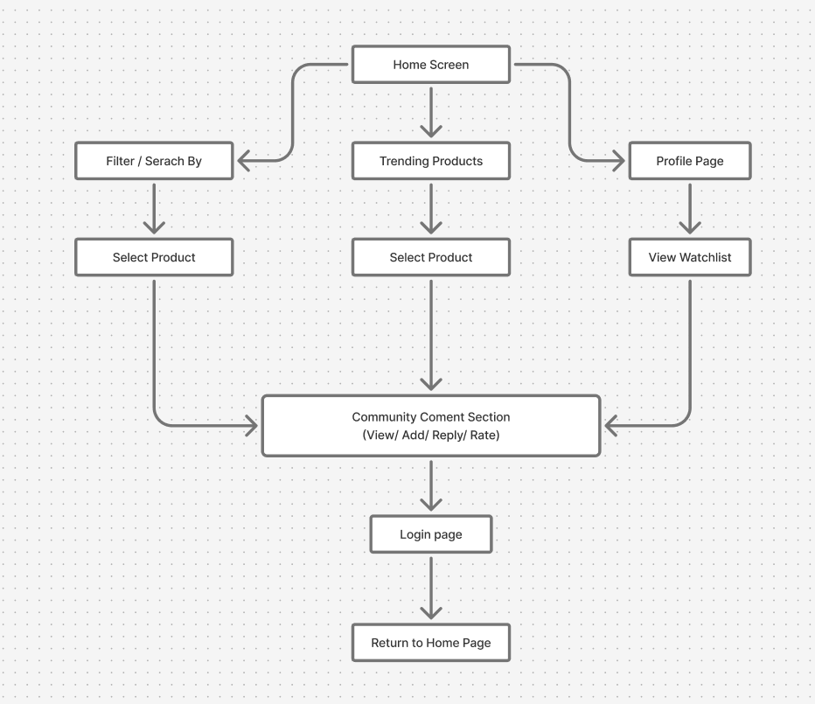
USER FLOW

Slide 13
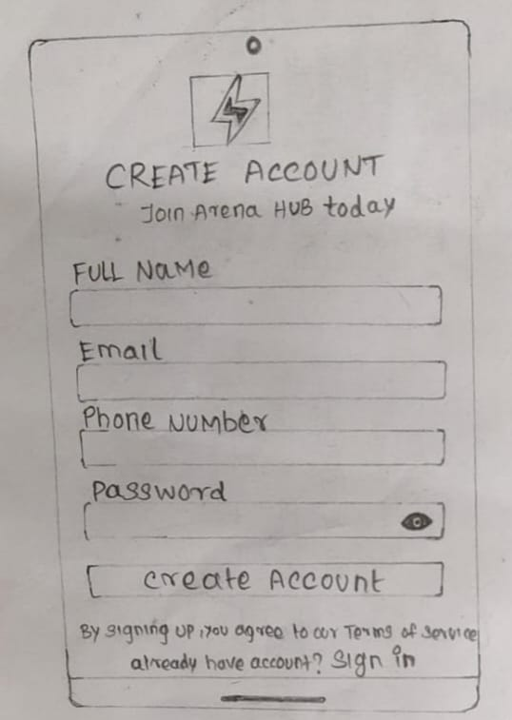
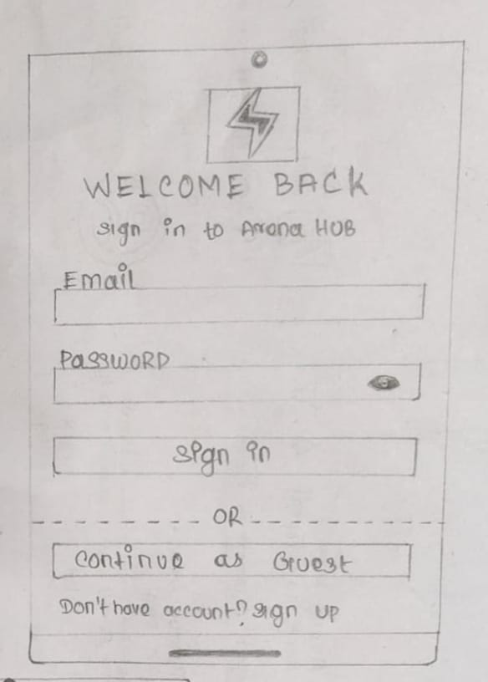
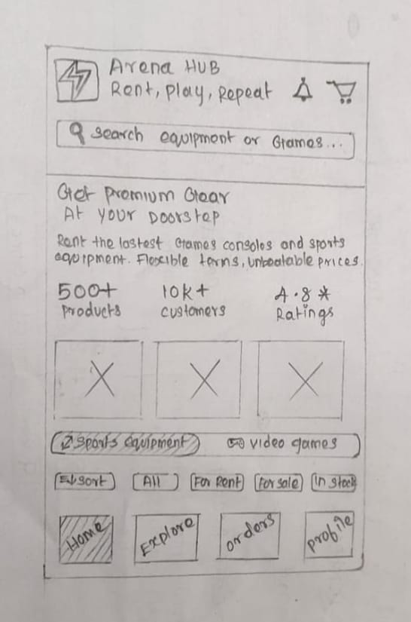
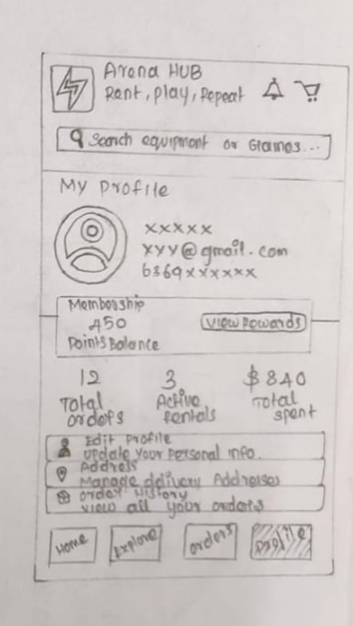
UI Design Kit: Low Fidelity
n
Login Sign In
Home page
Profile

Slide 14
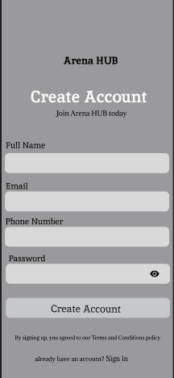
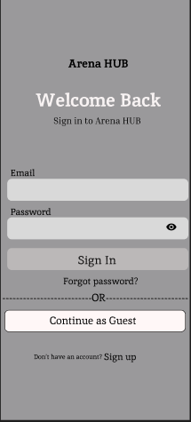
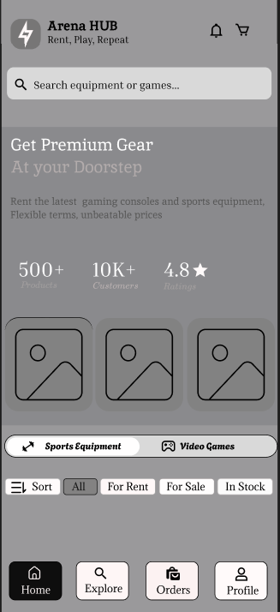
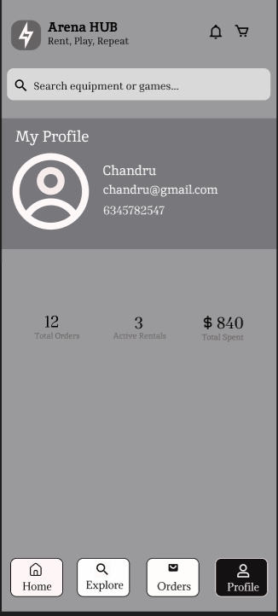
UI Design Kit: Mid Fidelity
Login Sign In
Home page
Profile

Slide 15
UI Design Kit: Colour
Background
Surface
Elevated
#070129
#C3BCBC
#FFFFFF

Slide 16
UI Design Kit: Colour
Black
Blue
Lite Green
#131111
#99E7FF
#AEF3A9

Slide 17
 | Font Size | Font Weight | Font Family | Colour Scheme
Heading 1 | 22 | Semi Bold | Poppins | Primary
Heading 2 | 18 | Semi Bold | Poppins | Primary
Heading 3 | 16 | Medium | Poppins | Primary
Body | 14 | Regular | Poppins | Secondary
Button | 14 | Semi Bold | Poppins | Primary
Caption | 12 | Regular | Poppins | Muted

Slide 18










UI Design Kit: Icons
Icons

Slide 19
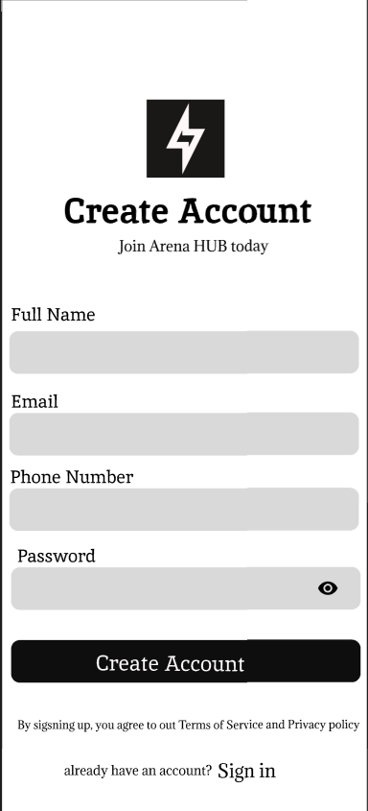
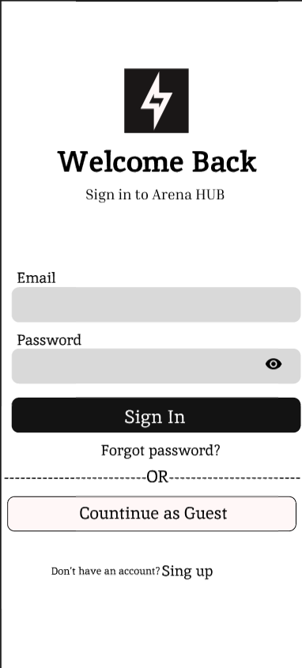
Low fidelity
High fidelity
Low fidelity
High fidelity
Sign In
Login
Sign In

Slide 20
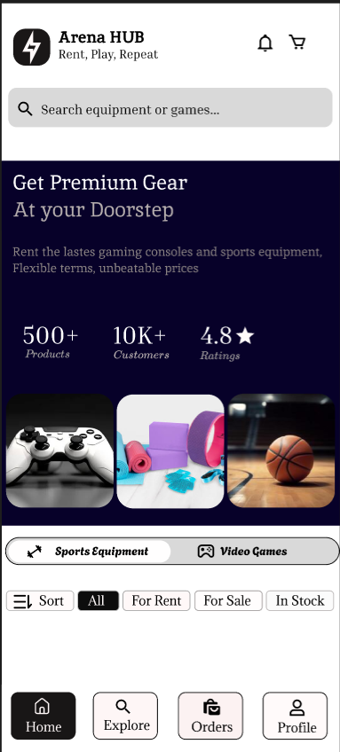
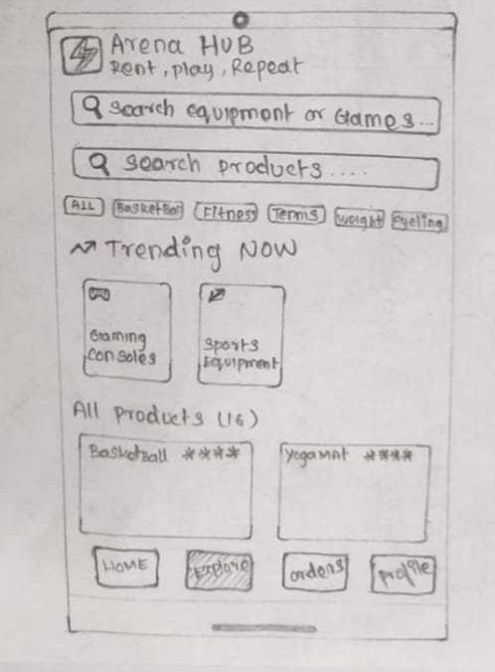
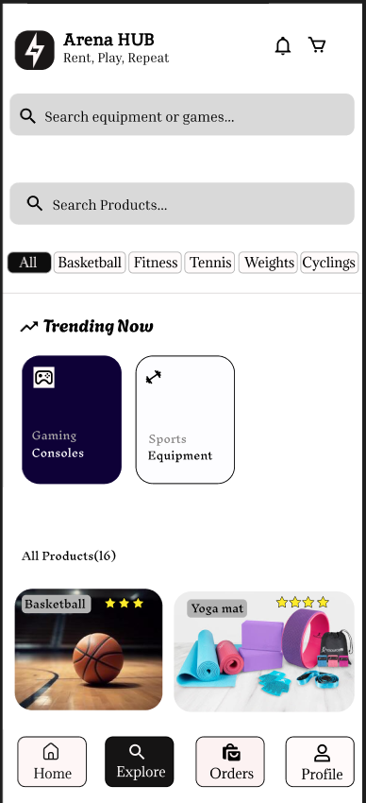
Low fidelity
High fidelity
Low fidelity
High fidelity
Home Page
Trending

Slide 21
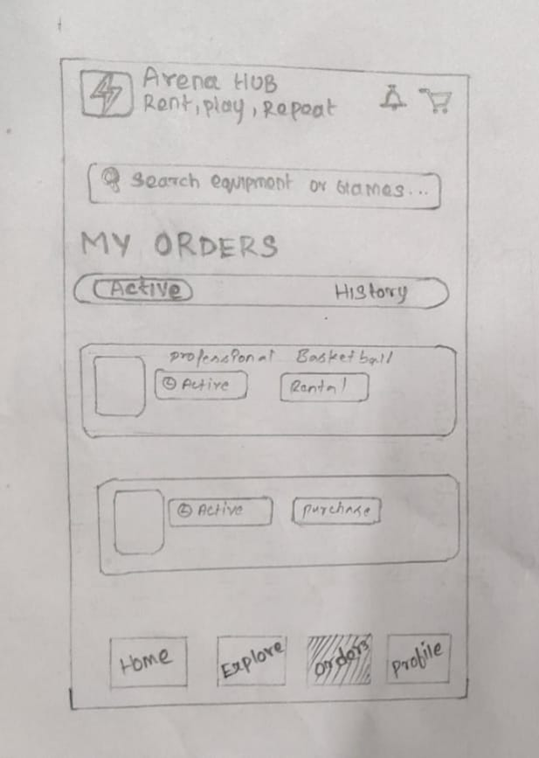
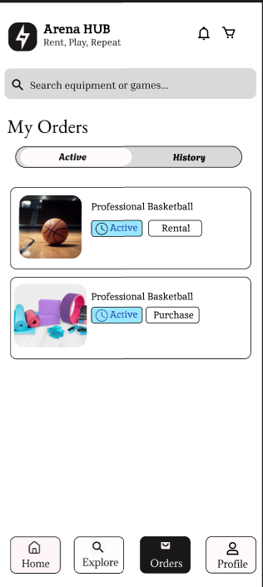
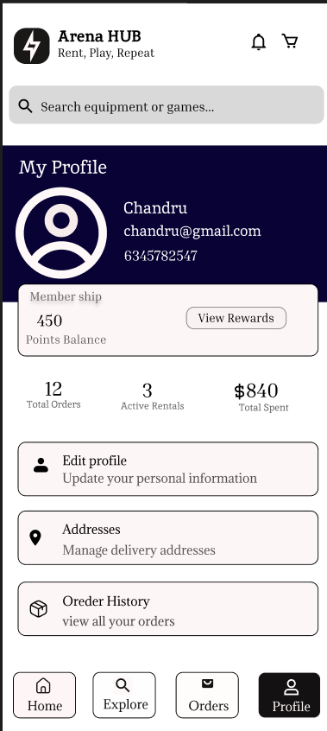
Low fidelity
High fidelity
Low fidelity
High fidelity
Order Page
Profile

Slide 22
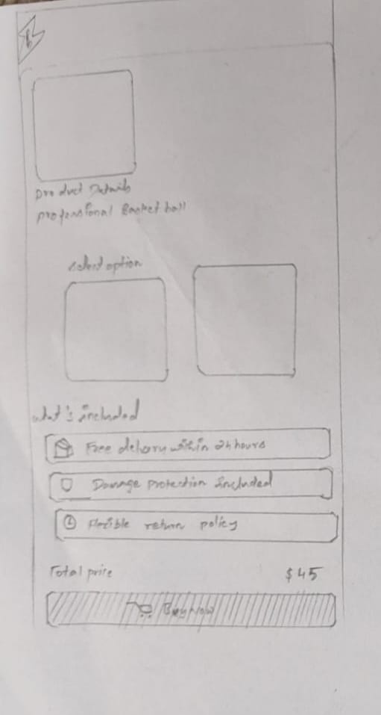
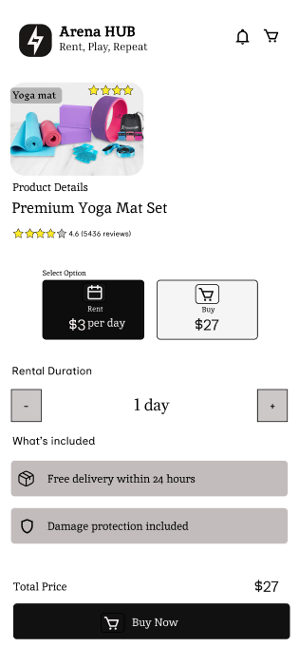
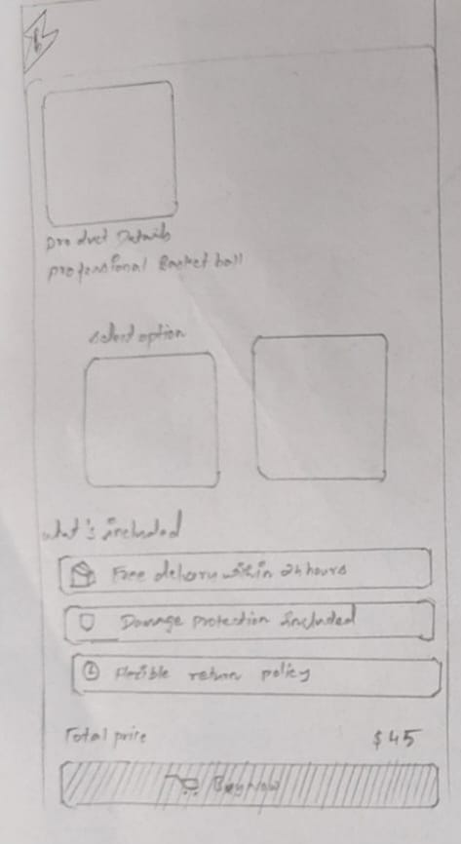
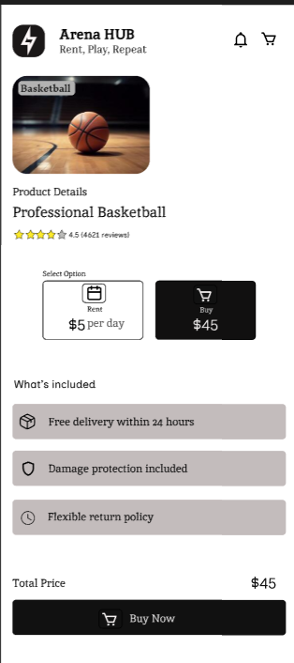
Low fidelity
High fidelity
Low fidelity
High fidelity

Slide 23
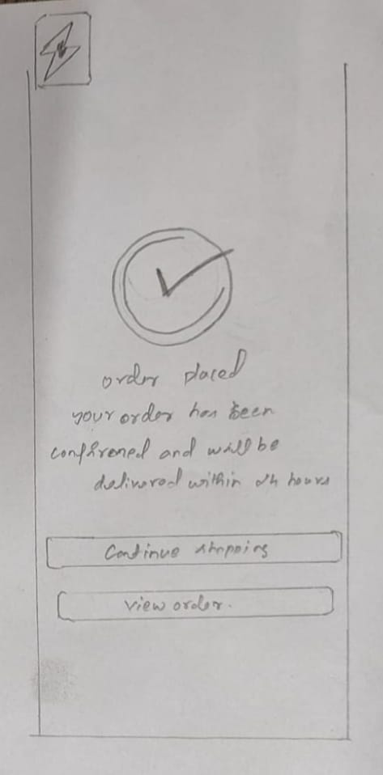
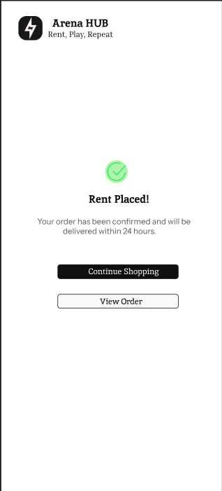
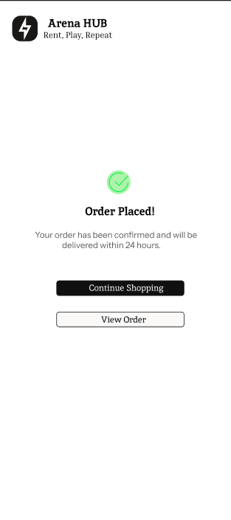
Low fidelity
High fidelity
Low fidelity
High fidelity
Rent Placed
Order Placed

Slide 24
UI Design Kit: Onboarding Screens
Login Page
Sign In Page

Slide 25
UI Design Kit: Home Page
Cart
Logo
Notification
Search
Prosters
Sports items
Video Games Items
Trendings
Orders
Home
Profile

Slide 26
UI Design Kit: Screens
Trending Page
Order Page

Slide 27
UI Design Kit: Screens
Rent Page
Rent Placed

Slide 28
UI Design Kit: Screens
Order Page
Order Placed

Slide 29
Thank You

